Slide 1

Context-Aware Self-Optimization of Topology Control Reconfigurations in Wireless Sensor Networks
Roland Kluge (A1)
Mahdi Mousavi (B3)
Martin Pfannemüller (A4)
Markus Tobias Weckesser (A4)
DFG Collaborative Research Center 1053 - MAKI Multi-Mechanism-Adaptation for the Future Internet

Slide 2




Why WSNs should be reconfigurable
Past
Present
Sensor node (powerful, weak)
Base station
Stakeholder/owner
Application
Observed area
Notes:
Image sources:
Actor: CC0 https://de.wikipedia.org/wiki/Datei:Robustness_Diagram_Actor.svg
Radio tower: https://www.iconfinder.com/icons/2135802/communication_network_tower_wifi_wifi_tower_icon
Circular arrows: CC-3.0-BY https://thenounproject.com/search/?q=updating&i=957153

Slide 3
MAPE-K for WSNs
Base station
A
P
K
Classic node
Adaptive, decentralized node
Cluster head node
E
M
A
P
E
K
M
A
P
E
K
Topology Control
Cluster head node
kTC
M
E
l*-kTC
Topology Control
Yao
LEACH
Modeled after: Portocarrero et al.: "Autonomic Wireless Sensor Networks: A Systematic Literature Review," J. Sensors, 2014 (http://dx.doi.org/10.1155/2014/782789 )

Slide 4
Topology-related excerpt of WSN config. space – components and parameters (single node)
System
Context
A
M
P
E
Use Case
Quality Criteria
Topology Monitoring
Topology Control
Pattern Matching
View size [ℕ]
TC period [s]
Centralized
Tracking
Energy efficiency
Continuous
Decentralized
Distributed
e.g., wildlife, wild fire, person
Measurement accuracy
Data collection
TM period
kTC
k[ℝ]
MAKI Seminar
2017-05-24
e.g., structural monitoring,
temperature, …
On demand
l*-kTC
k[ℝ]
a[ℝ]
Max. Robustness
Yao
n_{c}[ℕ]
Low overhead
Clustered
Node capability
Node mobility
LEACH
Position avail.
Speed [m/s]
Centralized
Energy level avail.
Global Spanning Tree
Local view storage [Nodes]
+ e.g., power control, network coding scheme, …

Slide 5
Topology-related excerpt of WSN config. space – constraints (single node)
Attribute value restrictions, e.g., sensible TC parameter values
Functional dependencies, e.g., auxiliary information for l*-kTC
Resource restrictions, e.g., pattern matching ( )
Not all components and attribute values can be consistently combined!
k[ℝ]
∈ [1, 1.41]
Topology Control
Use Case
l*-kTC
≪requires≫
Data collection
E
Node capability
Topology Control
Pattern Matching
Local view storage [Nodes]
< 2 hops &&
kTC
⇒
Distributed

Slide 6

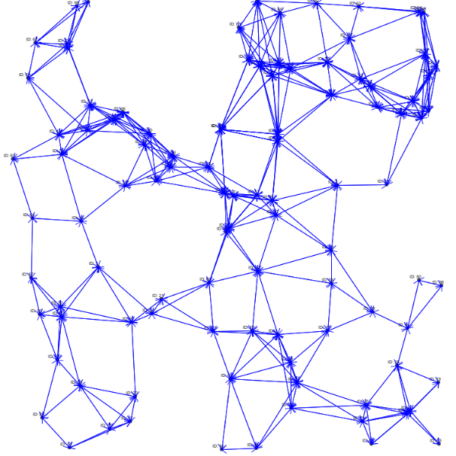
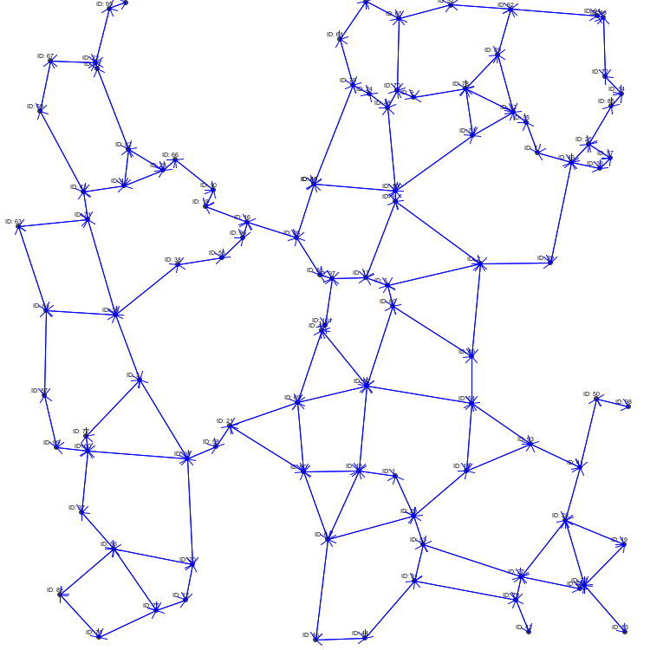
Topology Control to Improve Energy Consumption and Robustness of Communication Systems
Context A
Adaptation
Context B
Adaptation
Adaptation
Logic
Density: high
Configuration
Density: low
Configuration
Mobility: high
Aggressiveness: low
Mobility: low
Aggressiveness: high
…
Update interval: 1s
Context
Change
…
Update interval: 3s
…
…
Managed
Resources
(=Topology)
Topology Control
Mechanism - Variant A
Topology Control
Mechanism - Variant B
Communication link
Sensor node

Slide 7
Topology Control to Improve Energy Consumption and Robustness of Communication Systems
Hard constraints / contextual requirements:
Context A
Adaptation
Configuration 1
Valid configuration choices depend on
current system context
…
Configuration n
Soft constraints / quality goals:
Configuration 1
Configuration n
Non-functional properties
Context A
Context B
…
Context A
Context B
…
Avg. link lifetime
Performance highly depends on given system context
Latency
Throughput
Energy consumption
Measurable non-functional properties
with potentially conflicting quality goals

Slide 8
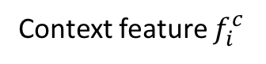
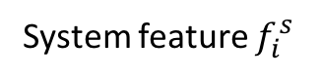
Context-Feature-Models [1]
Context features are given by environment and impose hard constraints on system
System feature $f_{i}^{s}$
limits valid configurations per context
Context feature $f_{i}^{c}$
[1] Saller, Karsten, Malte Lochau, and Ingo Reimund. "Context-aware DSPLs: model-based runtime adaptation for resource-constrained systems." Proceedings of the 17th International Software Product Line Conference co-located workshops. ACM, 2013.

Slide 9
Soft Constraints and Problem Statement
Find context-dependent run-time configuration of system which is optimal in regard to non-functional properties
Configuration 1
Configuration n
Non-functional properties
Context A
Context B
…
Context A
Context B
…
Avg. link lifetime
Performance highly depends on given system context
Latency
Throughput
Energy consumption
Sources of soft constraints for quality goals are
Measurement-based performance models
Domain knowledge

Slide 10
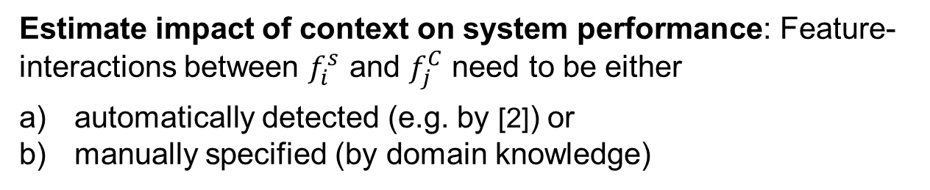
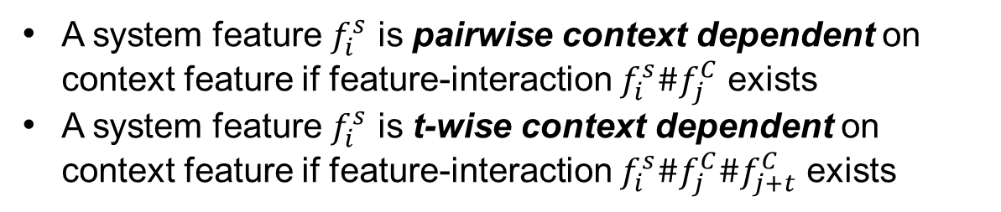
Identification of Context-Aware System-Features as Feature-Interaction Detection
A system feature $f_{i}^{s}$ is pairwise context dependent on context feature if feature-interaction $f_{i}^{s}\#f_{j}^{C}$ exists
A system feature $f_{i}^{s}$ is t-wise context dependent on context feature if feature-interaction $f_{i}^{s}\#f_{j}^{C}\#f_{j+t}^{C}$ exists
Estimate impact of context on system performance: Feature-interactions between $f_{i}^{s}$ and $f_{j}^{C}$ need to be either
automatically detected (e.g. by [2]) or
manually specified (by domain knowledge)
[2] Siegmund, Norbert, et al. "Predicting performance via automated feature-interaction detection." Software Engineering (ICSE), 2012 34th International Conference on. IEEE, 2012.

Slide 11
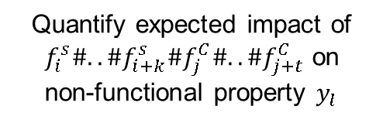
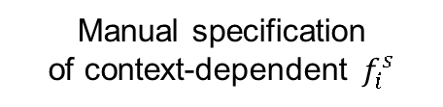
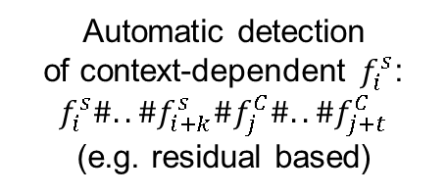
Overview on General Approach
1a
1b
Automatic detection of context-dependent $f_{i}^{s}$:
$$f_{i}^{s}\#..\#f_{i+k}^{s}\#f_{j}^{C}\#..\#f_{j+t}^{C}$$
(e.g. residual based)
Manual specification of context-dependent $f_{i}^{s}$
(Simulation)
data
2
Quantify expected impact of
$f_{i}^{s}\#..\#f_{i+k}^{s}\#f_{j}^{C}\#..\#f_{j+t}^{C}$ on
non-functional property $y_{l}$
3
Encode as
optimization problem
CFM
4
Derive optimal configuration in regard of (multiple) quality goals

Slide 12
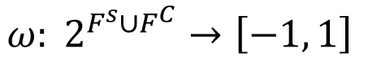
Quantification of Expected Impact of Context-Dependent System Feature Tuples
Encoding of quantified feature-interactions in model with weight function
$$ω: 2^{F^{s}∪F^{C}}→\left[−1, 1\right]$$
-1
0
1
Maximum negative correlation
No influence
Maximum positive correlation
Retrieved by performance model and/or domain knowledge

Slide 13
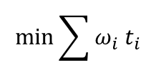
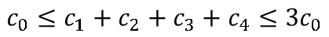
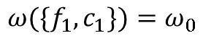
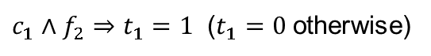
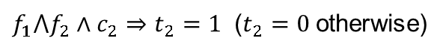
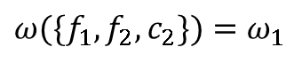
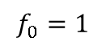
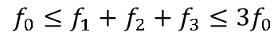
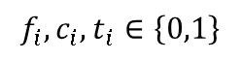
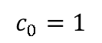
Formulations as Linear Optimization Model - Example
Soft Constraints
$ω({\{f}_{1}, c_{1}\})=$ $ω_{0}$
$ω({\{f}_{1},f_{2}, c_{2}\})=$ $ω_{1}$
Decision Variables
$$f_{i},c_{i},t_{i}∈\left\{0,1\right\}$$
Constraints
$$f_{0}=1$$
$$f_{0}≤f_{1}+f_{2}+f_{3}≤{3f}_{0}$$
Tree
Structure
Fixed Context
Features
+
$$c_{0}=1$$
$$c_{0}≤c_{1}+c_{2}+c_{3}+c_{4}≤{3c}_{0}$$
$c_{1}∧f_{2}⇒t_{1}=1$ ($t_{1}=0$otherwise)
Soft Constraints
$f_{1}⋀f_{2}∧c_{2}⇒t_{2}=1$ ($t_{2}=0$otherwise)
Objective
$$\min{\sum{ω_{i} t_{i}}}$$
per measured metric
→Selects configuration with minimal expected $ω$

Slide 14
Distributed Approach
Central Approach
With Shared
CFM Specification
A
A
A
A
A
A
Agent
Local Data

Slide 15




Resource selection problem
A set of finite resources are to be shared among a set of agents.

Slide 16


Resource selection problem
A set of finite resources are to be shared among a set of agents.

Slide 17
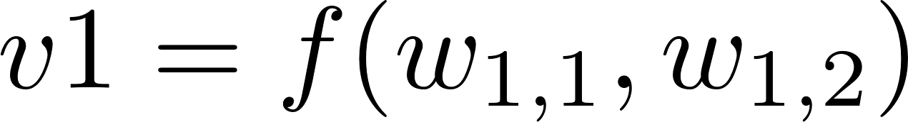
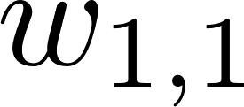
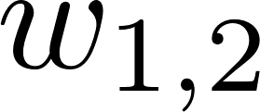
Resource selection problem
A set of finite resources are to be shared among a set of agents.

Slide 18

Resource selection problem
A set of finite resources are to be shared among a set of agents.
Optimization problem: NP
Distributed approach? → GAME THEORY

Slide 19


Game theory
Modeling competitive situations
Competition among agents
Each tries to maximize its own revenue
Non-cooperative game:
A set of players:
A set of action set for every player:
A cost function:

Slide 20

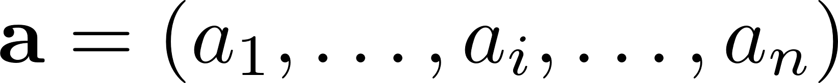
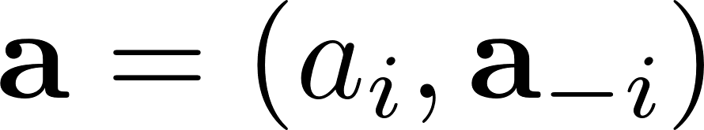
Game theory
Modeling competitive situations
Competition among agents
Each tries to maximize its own revenue
Non-cooperative game:
A set of players:
A set of action set for every player:
A cost function:
Action of node:
Action profile of the game:

Slide 21

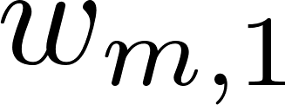

Resource selection from the agents’ perspective
Action: choosing a link to minimize the cost
Cost: depends on the action profile

Slide 22
Resource selection from the agents’ perspective
Action: choosing a link to minimize the cost
Cost: depends on the action profile

Slide 23
Resource selection from the agents’ perspective
Action: choosing a link to minimize the cost
Cost: depends on the action profile
How to define the cost to minimize our objective function?
The decision of a self-interested agent may not be in favor of the global objective!

Slide 24
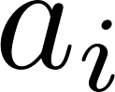
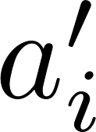
Some definitions in game
Exact potential game:
An important class of game
A function can be used to analyze the game
An update occurs when

Slide 25

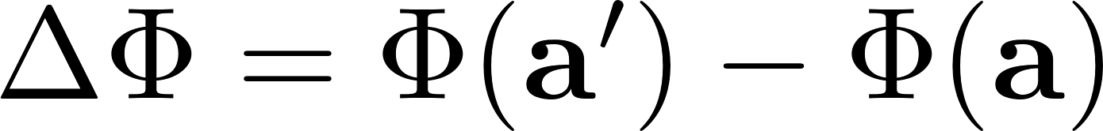

Some definitions in game
Exact potential game:
An important class of game
A function can be used to analyze the game
An update occurs when
The game is exact potential if there exists a function such that in case of a change

Slide 26
Some definitions in game
Exact potential game:
An important class of game
A function can be used to analyze the game
An update occurs when
The game is exact potential if there exists a function such that in case of a change

Slide 27
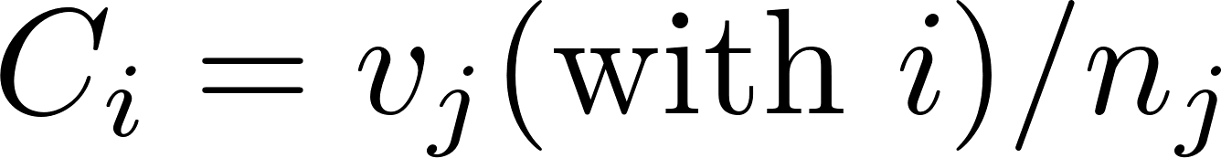

Some definitions in game
Marginal contribution cost function:
If an agent i choose a resource j,
Equal-share cost function:
If an agent i choose a resource j,
1
3
2
6
9
2
7

Slide 28
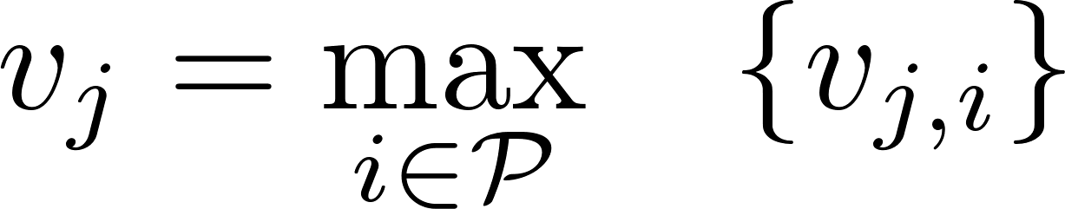
Some definitions in game
Marginal contribution cost function:
If an agent i choose a resource j,
Equal-share cost function:
If an agent i choose a resource j,
Illustration:
Let v be a maximum selection function
1
3
2
6
9
2
7

Slide 29
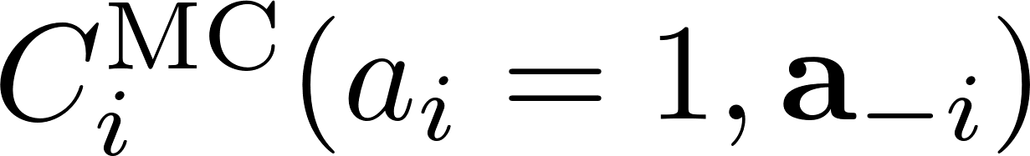

Some definitions in game
Marginal contribution cost function:
If an agent i choose a resource j,
Equal-share cost function:
If an agent i choose a resource j,
Illustration:
Let v be a maximum selection function
1
3
2
6
9
2
7

Slide 30
Some definitions in game
Marginal contribution cost function:
If an agent i choose a resource j,
Equal-share cost function:
If an agent i choose a resource j,
Illustration:
Let v be a maximum selection function
1
3
2
6
9
2
7

Slide 31
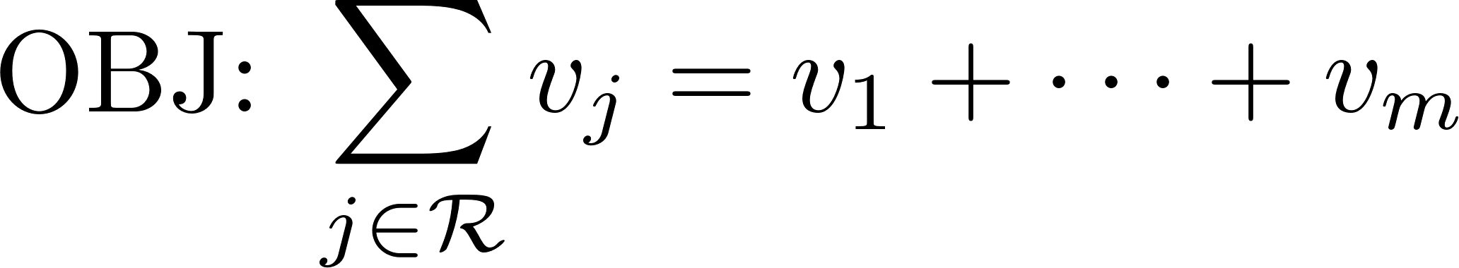
Theorem
In any resource selection problem
with separable global objective
the problem can be approximated by a distributed approach
by a using a non-cooperative cost-sharing game.
THEN the game will be a potential game with guaranteed convergence

Slide 32
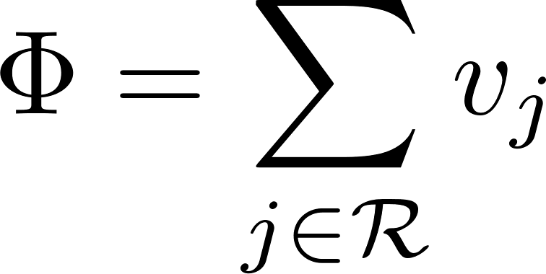

Theorem
In any resource selection problem
with separable global objective
the problem can be approximated by a distributed approach
by a using a non-cooperative cost-sharing game.
THEN the game will be a potential game with guaranteed convergence
with MC cost:

Slide 33
Distributed Approach
Central Approach
With Shared
CFM Specification
A
A
A
Local Data
A
A
A
Agent

Slide 34
Thanks!

